Slide 1

Apriori Algorithm
Presenter: Emmanuel Derry

Slide 2
Introduction
The Apriori algorithm is a classical data mining algorithm used for discovering frequent {itemsets} in large datasets. The Apriori algorithm aims to find all frequent itemsets in a transactional dataset.

Slide 3
Steps of the Algorithms
Candidate Generation
Support Counting
Once the candidate itemsets are generated, the algorithm scans the dataset again to count the support of each candidate itemset
In the first iteration, the algorithm scans the dataset to identify the frequent individual items. These items are considered as frequent itemsets of length 1.

Slide 4
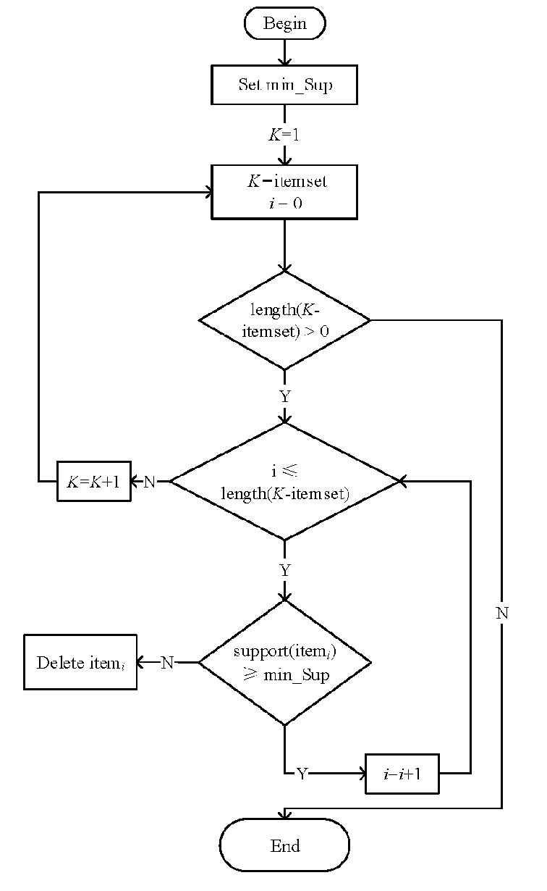
Apriori flowchart

Slide 5
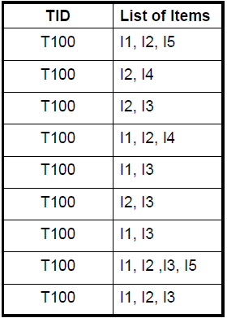
The Apriori Algorithm : Example
Consider this database with 9 transactions
Suppose minimum support is 2 (2/9=22%)
We can find out the frequent item set using Apriori algorithm.

Slide 6
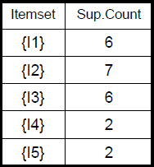
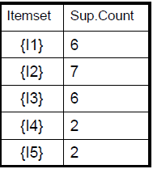
Step 1: Generating 1-itemset Frequency Pattern
Scan D for count of
each canditafdate
Compare candidate support count with minimun support count
C1
L1
In the first iteration of the algorithm, each item is a member of the set of canditate.
NB: Provide those members satisfy the minimumn suport.

Slide 7
Step 2: Generating 2-itemset frequency
To discover the set of frequent 2-itemsets, L2 , the algorithm uses L1 Join L1 to generate a candidate set of 2-itemsets, C2.
Next, the transactions in D are scanned and the support count for each candidate itemset in C2 is accumulated.
The set of frequent 2-itemsets, L2 , is then determined, consisting of those candidate 2-itemsets in C2 having minimum support.

Slide 8
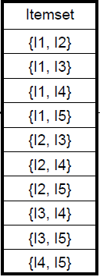
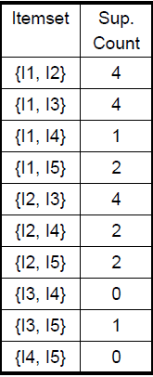
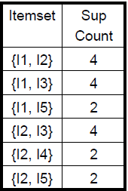
Step 2 Results.
Generarted C2 candidate from L1
Scan D count of each candidate.
Compare candidate support count with minimum suport count
L2
C2
C2

Slide 9
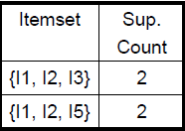
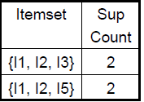
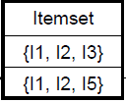
Step 3 : Generating 3-items Frequency
Compare candidate support count with the minimum support count
Scan D for count of each candidate frequency
Scan D for count of each candidate
C3
C3
L3
The generation of the set of candidate 3-itemsets, C3 , involves use of
the Apriori Property.
• In order to find C3, we compute L2 Join L2.
• C3 = L2 Join L2 = {{I1, I2, I3}, {I1, I2, I5}, {I1, I3, I5}, {I2, I3, I4}, {I2, I3,
I5}, {I2, I4, I5}}.

Slide 10
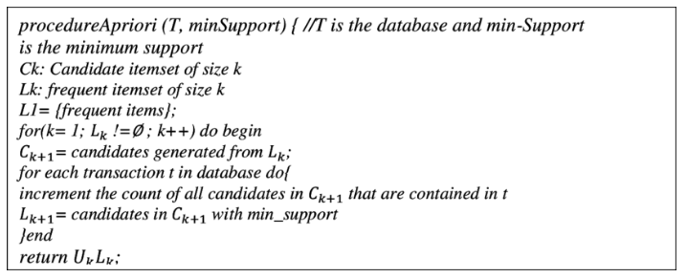
Psuedo Code

Slide 11
Prove of Termination
Monotonicity of Items
That’s if an itemset is infrequent all of it supersets will be infrequent.
Level-wise Approach
Apriori Algorithm
The Apriori algorithm employs a level-wise search strategy, where it generates candidate itemsets of a specific size (k) based on frequent itemsets of size k-1
Support-based Pruning
A minimum support threshold is set, and any itemset that falls below this threshold is considered infrequent and discarded.

Slide 12
Prove of Apriori using example.
The algorithm uses L3 Join L3 to generate a candidate set of 4-itemsets, C4. Although the join results in {{I1, I2, I3, I5}}, this itemset is pruned since its subset {{I2, I3, I5}} is not frequent.
• Thus, C4 = φ , and algorithm terminates, having found all of the frequent items. This completes the Apriori Algorithm.

Slide 13
Prove of Apriori Algorithm termination.
The termination occurs because the algorithm either exhausts the search space or prunes all the infrequent itemsets, leading to the discovery of all the frequent itemsets within the specified support threshold.
The termination of the Apriori algorithm does not guarantee an optimal or efficient solution in all cases, as the algorithm's performance heavily depends on the characteristics of the dataset and the chosen support threshold

Slide 14
Apriori Algorithm Complexities
Time complexity
Candidate Generation: O(k * n) k length of itemset n=no. frequent itemset
Support Counting: O(m * t), where m is the number of candidate itemsets and t is the number of transactions in the dataset.
Iterations: O(max_length * iterations).
O((k*n*m*t*) * (max_length* iterations))
01
Space Complexity
The space complexity of the Apriori algorithm primarily depends on the number of candidate itemsets generated in each iteration and the size of the dataset.
Therefore, the space complexity can be represented as O(m * max_length), where m is the number of candidate itemsets
01

Slide 15
Use case of Apriori Algorithm
DNA Sequencing:
In bioinformatics, the Apriori algorithm can be employed to analyze DNA sequences and identify frequent subsequences. This information is valuable for understanding genetic patterns, discovering motifs, and detecting genetic variations or mutations.
Web Usage Mining:
In web usage mining, the Apriori algorithm can be employed to discover patterns in user navigation behavior on websites. It helps identify frequent sequences of pages visited by users, which can be utilized for improving website design, optimizing user flow, and personalizing content delivery.
Used in domains such as customer behavior analysis, and recommendation systems.

Slide 16
Candidate Generation Step
This is responsible for generating all possible candidate itemsets of a given size.
The candidate generation step is typically the most computationally expensive step.

Slide 17
The generation Process
This works by iteratively generating candidate itemsets of increasing size.
In the first iteration, generates all possible 1-itemsets.
In the second iteration, generates all possible 2-itemsets that are formed by combining two 1-itemsets that appear in the same transaction.
In the third iteration, generates all possible 3-itemsets that are formed by combining three 2-itemsets. This goes on till the generation of the K-itemsets

Slide 18
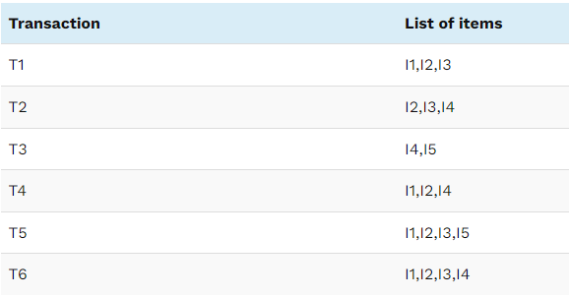
Sample Dataset

Slide 19
Apriori Property
The candidate generation step uses a property called the Apriori property to prune the search space.
That is if an itemset is not frequent, then none of its supersets can be frequent.
Allows the Apriori algorithm to avoid generating and counting candidate itemsets that are not likely to be frequent

Slide 20
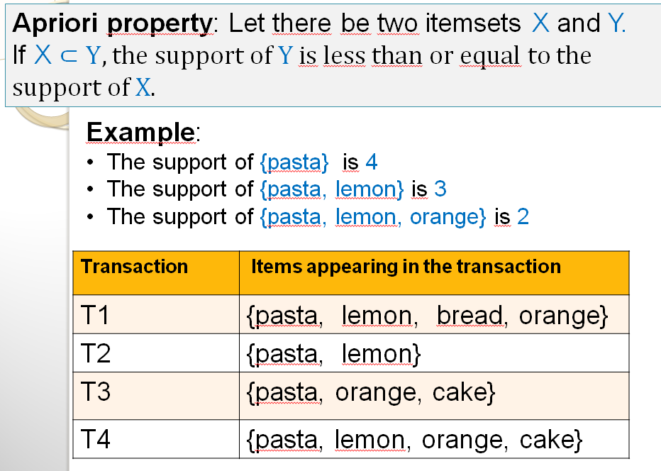
Apriori Property Example

Slide 21
Ways to Improve the Apriori Algorithm

Slide 22
Candidate generation Implementation
Using a hash table to store the itemsets that have already been generated.
This allows the candidate generation step to quickly check if a candidate itemset has already been generated.
Using Backtracking algorithm: The backtracking algorithm starts with a set of 1-itemsets and then recursively generates all possible candidate itemsets of increasing size.
The Backtracking is more efficient, however very difficult to implement
Notes:
The efficiency of the candidate generation step can have a significant impact on the overall performance of the Apriori algorithm.

Slide 23
The Counting Step
It is responsible for counting the number of times each candidate itemset appears in the dataset.
The counting step is typically much faster than the candidate generation step.

Slide 24
Counting steps Implementation
Using a hash table: Store the transactions that contain each candidate itemset. The items can be accessed quickly in the counting step.
MapReduce algorithm: The MapReduce algorithm will divide the dataset into a number of smaller partitions. Each partition is then assigned to a different mapper. The mappers count the number of times each candidate itemset appears in their respective partitions.
The result from the mappers are combined to produce the final count
Notes:
The efficiency of the candidate generation step can have a significant impact on the overall performance of the Apriori algorithm.

Slide 25
Trie-Based Apriori
A tree-like data structure called a Trie, which stands for "reTRIEval," is used to hold a dynamic set of strings.
Each string serves as an itemset in the context of the Apriori algorithm, and the Trie structure facilitates efficient organization and search of these itemsets.
The root is deﬁned to be at depth 0 and a node at depth d can point to nodes at depth d + 1
Each node represents an item sequence which is the concatenation of labels of the edges that are on the path from the root to the node so that a path from the root to each node represents an itemset
the value of each node is the support count for the itemset it represents

Slide 26
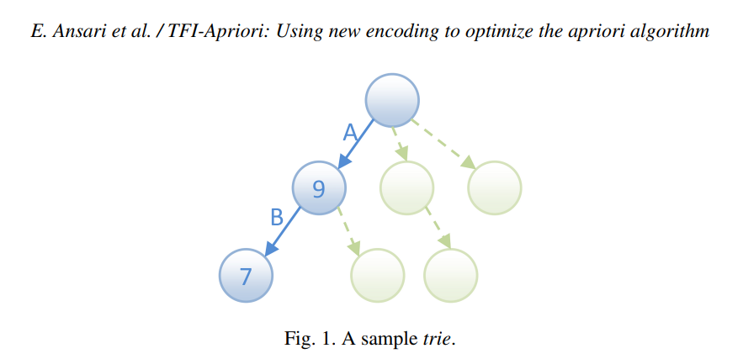
Notes:
A and B are the item set and 9 ad 7 are the support count.

Slide 27
How trie Optimize the algorithm
Reduce Redundant Scans
Efficient Candidate generation
Quick superset/Subset Checks

Slide 28
Complexities
The overall time complexity of the Apriori algorithm with Trie structures is dominated by support counting, which is linear in the number of transactions (O(n)). The constant-time complexities for candidate generation and pruning significantly reduce the computational load compared to the non-Trie version of the algorithm.
Notes:
Candidate Generation with Tries:
Time Complexity: O (1)
Support Counting with Tries:
Time Complexity: O(n)
Space Complexity with Tries:
Space Complexity: O(M),

Slide 29
Parallel Processing (MapReduce)
Candidate itemset generation and frequent itemset generation are the two key iterative steps that make up the Apriori algorithm
Each task scans the database, produces local candidates using Mapper, and then sums the local count and outcomes from frequent itemsets using Reducer.

Slide 30
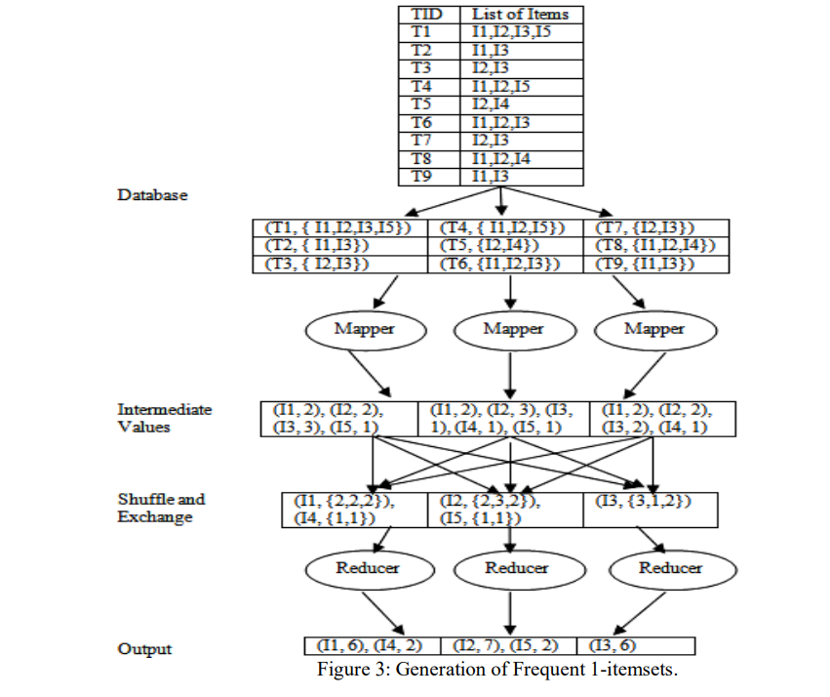
The MapReduce framework

Slide 31
Performance Trade-Off
Performance Trade-offs:
While Hadoop MapReduce can significantly improve the efficiency of Apriori for large datasets, there may be some performance trade-offs, such as increased overhead due to data serialization and deserialization. However, the benefits of distributed processing often outweigh these trade-offs.

Slide 32
Complexities of MapReduce Framework
The MapReduce-based Apriori algorithm's overall time complexity is influenced by the step that takes the longest to complete, which is typically the support counting phase. Since n is the number of transactions and k is the largest possible itemset size, the time complexity is frequently O (n * k).
Notes:
MapReduce for Pruning:
Time Complexity: O(k).
MapReduce for Support Counting:
Time Complexity: O(n * k)
MapReduce for Candidate Generation:
Time Complexity: O(n * k * m),

Slide 33
Thank you

